Slide 2

Web Component
Notes:
Does anyone know web component?
Have you ever inspected web page and seen weird tag? https://www.webcomponents.org
Have you ever gotten trouble with conflict CSS? What is solution? Rename, longer selector path, or !important?

Slide 3
Agenda
Web Component
Custom Element
Shadow DOM
Examples
Q&A

Slide 4
Web component
HTML Template
Custom Element
Shadow DOM
HTML Import
Notes:
HTML Import: document.importNote(externalNode, deep), copy a node from a document. Use appendChild() or insertNode() to add imported node.

Slide 5
Custom Element
Define your HTML tag
Extend existing HTML tag
Less code, modular code, and more reuse
Notes:
HTML is declarative, portable, well supported, and easy to work with.
Its tag are limited.
Custom element creates new tag while preserving the benefits of HTML

Slide 6
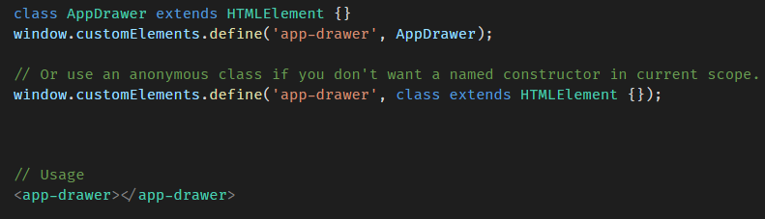
Custom Element - Define
A class extends HTMLElement
Tag naming must contain a dash (-).
Notes:
Custom element inherits then entire DOM API.
We can define new property, new event, content, handle event of custom element.
This in class refs to DOM element itself.
Duplicated tag -> DOMException
Custom element cannot be self-closing. Dif with void elements: br, hr, img,…
Custom elements can be used before their definition is registered.
customElements.whenDefined('app-drawer').then(() => { console.log('ready!'); });

Slide 7
Custom Element – lifecycle hooks
Name | Called when
Constructor | An instance of the element is created or upgraded
connectedCallback | Every time the element is inserted into the DOM.
disconnectedCallback | Every time the element is removed from the DOM.
attributeChangedCallback(attrName, oldVal, newVal) | An observed attribute has been added, removed, updated, or replaced.
adoptedCallback | The element has been moved into a new document.
Notes:
Upgraded: use before registering. When registered => be upgraded
connectedCallback: do expensive things
disconnectedCallback: clean up, won’t be called when user close tab.
Static observedAttributes property
Reaction callbacks (hooks) are synchronous.
DEMO: disconnectedCallback

Slide 8
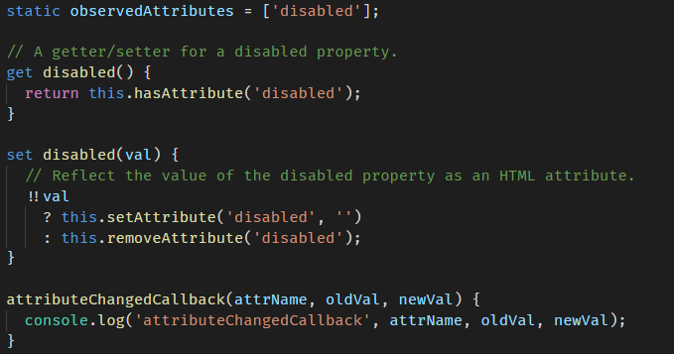
Custom Element – props and attributes
Reflecting between DOM properties and HTML attributes
observedAttributes property
Notes:
keep the element's DOM representation in sync with its JavaScript state.
React on change of attribute – observedAttributes and attributeChangedCallback
DEMO: inputgroup - lifecycle hook

Slide 9
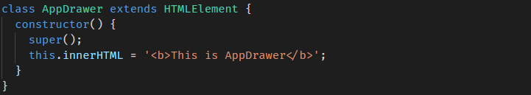
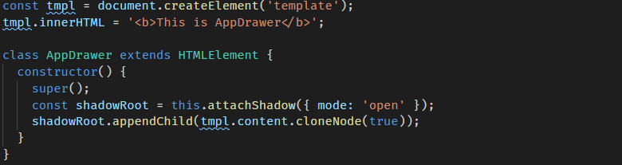
Custom Element - content
Using innerHTML property
Using HTML template
Notes:
innerHTML isn’t a good idea. Why? Users will loss their markup inside custom element
we use a template element to clone DOM, instead of setting the innerHTML of the shadowRoot. This technique cuts down on HTML parse costs because the content of the template is only parsed once, whereas calling innerHTML on the shadowRoot will parse the HTML for each instance.
DEMO: inputgroup - with template and shadow

Slide 10
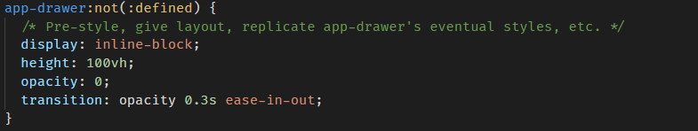
Custom Element – styling
Similar with defined HTML tag
Pre-styling unregistered element
Notes:
DEMO:
inputgroup-styling
inputgroup - not defined

Slide 11

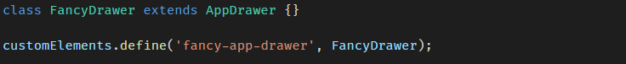
Custom Element – Extending
Native HTML element
Another custom element
Notes:
let button = new FancyButton();
<!-- This <button> is a fancy button. --> <button is="fancy-button" disabled>Fancy button!</button>
// Custom elements overload createElement() to support the is="" attribute. let button = document.createElement('button', {is: 'fancy-button'});

Slide 12
Shadow dom
Isolated DOM
Scoped CSS
Composition
Simplifies CSS
Productivity
Notes:
issues
Conflict id/class
Css
Isolated DOM: A component's DOM is self-contained (e.g. document.querySelector() won't return nodes in the component's shadow DOM).
Scoped CSS: CSS defined inside shadow DOM is scoped to it. Style rules don't leak out and page styles don't bleed in.
Composition: Design a declarative, markup-based API for your component.
Simplifies CSS - Scoped DOM means you can use simple CSS selectors, more generic id/class names, and not worry about naming conflicts.
Productivity - Think of apps in chunks of DOM rather than one large (global) page.

Slide 13
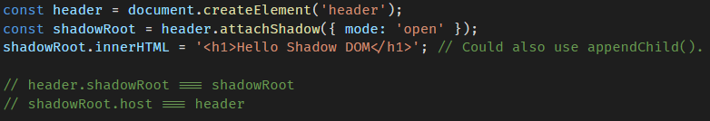
Shadow dom - creating
Element.attachShadow()
<slot> element
Render the user's markup over here
Notes:
With shadow DOM, you create a scoped DOM tree that's attached to the element, but separate from its actual children.
This scoped subtree is called a shadow tree. The element it's attached to is its shadow host.
A shadow root is a document fragment that gets attached to a “host” element.
Element that can’t host a shadow tree: textarea, input, img,
Slots are placeholders inside your component that users can fill with their own markup.
Slot is select by its name. Slots don't physically move DOM; they render it at another location inside the shadow DOM.

Slide 14
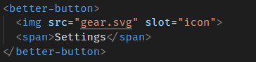
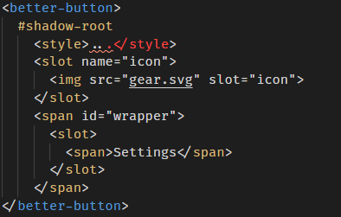
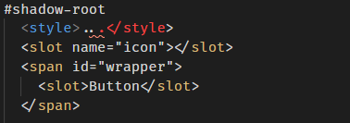
Shadow dom vs. light dom
Notes:
Demo: inputgroup-slot

Slide 15
Shadow dom - styling
CSS selectors used inside shadow DOM apply locally to your component.
Styling based on context
Styling distributed nodes
Styling a component from the outside
Notes:
:host-context(<selector>) matches the component if it or any of its ancestors matches <selector>.
Styling distributed nodes: Styles that applied before distribution continue to apply after distribution.
Outside styles always win over styles defined in shadow DOM.
DEMO:
inputgroup - style by context
inputgroup - style slot

Slide 16
Shadow dom – Event model
Look like event comes from the host component.
Custom DOM event
Internal by default
compose property
delegatesFocus property
Notes:
DEMO:
inputgroup - cross shadow boundary
inputgroup - composed event
inputgroup - delegatesFocus

Slide 17
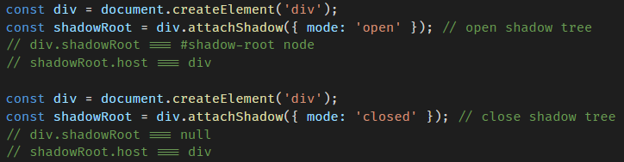
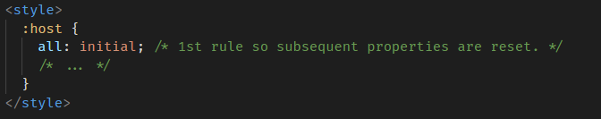
Shadow dom – More
Opened vs closed
Resetting inheritable styles

Slide 18
Examples
Checkbox
Card
Tab

Slide 19
Q&A
Notes:
// "tabs" is not a valid custom element name document.createElement('tabs') instanceof HTMLUnknownElement === true // "x-tabs" is a valid custom element name document.createElement('x-tabs') instanceof HTMLElement === true

